Slide 1
EJ EO292
Mapping Tools & Hub Project
Emad Khatib & Matthew McLamb
DIT – PMO & Data Division
EJ Council Meeting
July 23, 2024

Slide 2
Agenda
Project Status, Accomplishments, and Work in Progress
Protype Demo
Next Steps

Slide 3
Project Status
Overall Project Status | Public participation & feedback SC
Area | Status – DIT | Status – Agencies
Project Management Office
Deliverable - Scope Document | Complete 3/19/24 | Complete
Council Approval | Complete 4/1/24
Design – Mapping Tool
Hub Website Development | In Progress
Council Approval – Design Prototype | 6/3/24
Data Acquisition
Data Symbology* | TBD | TBD
MVP Development | In Progress
Council Approval – MVP Prototype
MVP
Roll Out
Based on the feedback from Subcommittee
DHHS – data layer “Number of Extreme Heat Days per Year". We are looking to see if there is another source.

Slide 4
Project Timeline
Phase | Task | 2024 January | Feb | March | April | May | June | July | August | September | October
I | Coordinate data with Agency (DEQ)
I | Coordinate data with Agency (DHHS)
I | Coordinate data with Agency (DOT)
I | Coordinate data with Agency (NCORR)
I | Develop Data Assessment Document
I | Data Assessment
I | Develop Requirements Document
I | Develop a gap analysis, if observed/needed
I | Present findings to project sponsors & Council members
I | Approval of requirements from Council
II | Identify all data sources and determine if data agreements are needed
II | Develop a design framework
II | Coordinate design with agencies
II | Develop prototype and discuss with agencies
IIH | Create Hub site instance
IIH | Prepare Site mockup for prototype demo
IIH | Prepare site content
II | Present prototype progress to Council |  |  |  |  | Done
IIH | Complete hub site design and layout
II | Finalize prototype with agencies
II | Protype Demo to council / subcommittee (if needed)
II | Approval - prototype from council |  |  |  |  |  | Done
III | MVP development (Mapping tool & Hub site)
III | Initial MVP presentation to Council |  |  |  |  |  |  | 7/23
III | Test MVP (agencies, some council members/subcommiittee, selected public participants, project team)
III | Demo MVP to council |  |  |  |  |  |  |  | 8/20
III | Approval - MVP from council
III | Roll out MVP

Slide 5
Status
Obtained council’s approval on the revised requirements document
  Prisons
  State Owned Lands
  State Tribal Boundaries
  CDC Environmental Justice Index
  EPA Environmental Quality Index
Changed the basemap to “Topographic” for improved legibility
Work continues on the 34 recommendations provided by the subcommittee
Hub Site content text has been created.
EJ Hub Site introduction text and Grants intake form are outstanding from the Subcommittee/Council.
Rec. Period | # of Items | Accept | Reject | Need (GO) Approval | Need Info from Council | Complete To-Date | In Progress
For Prototype | 23 | 22 | 1* | 1*** |  | 21 | 2
Grants | 2 | 2 |  |  |  |  | 2
By MVP | 9 | 8 | 1** |  | 2**** | 2 | 6
Total | 34 | 32 | 1 |  | 1 | 23 | 10
* Turn on/off layers with one click is not available within the application – Enhancement
** Unable to clip the NOAA data. Dropped
*** Additional layers – Approved & Added
**** EJ Hub Site & Mapping Tool Intro + Grant Intake Form Info. Council to provide text & input

Slide 6
Agenda
Project Status, Accomplishments, and Work in Progress
MVP Protype Demo
Next Steps

Slide 7
MVP Protype Demo Overview
The demo for the Hub and the mapping Tool will display data related to
  Climate stressors (flooding and sea level rise risk)
  Demographics
  Environmental (i.e. air quality permit sites, permitted facilities location…etc.)
  Geographic ( AIANA)
  Health data
  DOT (TDI)
  Sensitive receptors (prisons, state owned lands, broadband, schools, nursing homes, and affordable housing communities)
The Hub Website
  The Hub Website will host relevant grant information, including links to external resources
  The Hub Website will also link to the EJ Mapping Tool
EJ Hub: https://www.ejhub.nc.gov/
EJ Mapping Tool: https://experience.arcgis.com/experience/4c9561f7a1a7415d86201a785753e56f/page/Page/

Slide 8
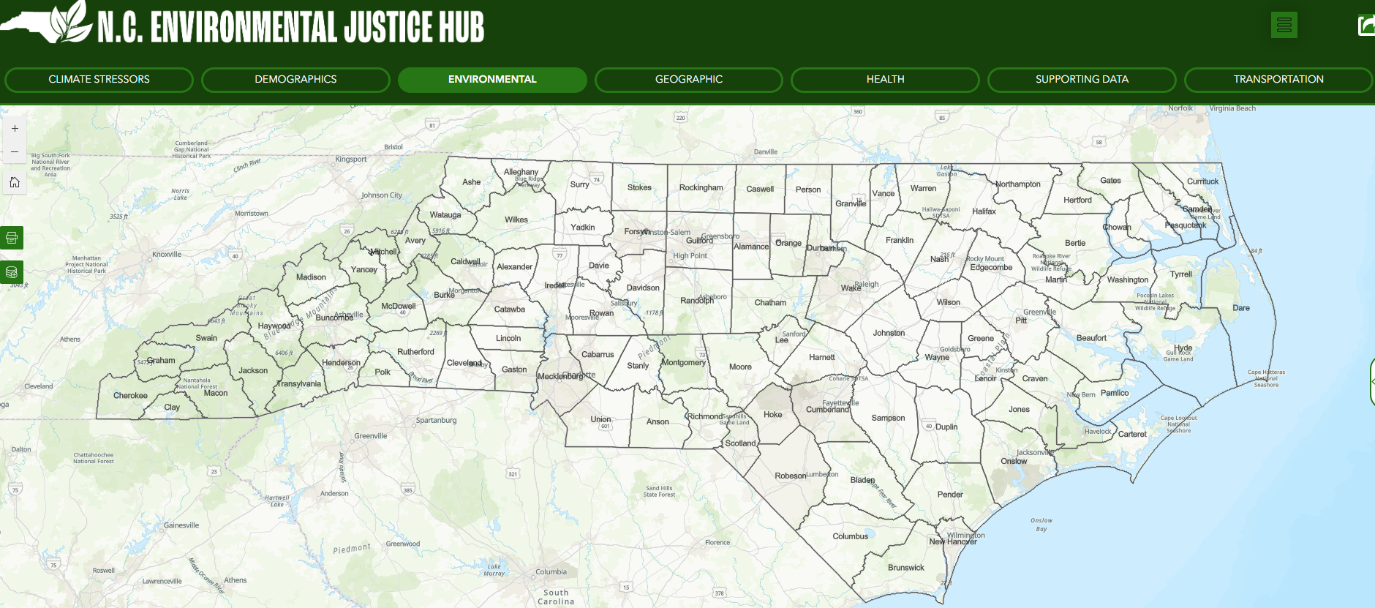
MVP Prototype Demo – EJ Mapping Tool
 | Agency Mapping Tools
Data Element | DEQ's Environmental Justice Tool & Community Mapping System | DHHS Environmental Health Data Dashboard | DOT's EJ and Transportation Disadvantage Index mapping tool
Demographic Data on Census Block Level | X | X | X
Permitted Facility Locations | X | X
Relevant Health Data on smallest geographic scale publicly available | X | X | X
Ambient air quality data | X | X
Climate stressors such as flooding and sea level rise risk | X
Locations of sensitive receptors such as:
Schools | X | X
Nursing Homes | X | X
Affordable Housing Communities
Grants
Prisons & State-Owned Properties

Slide 9
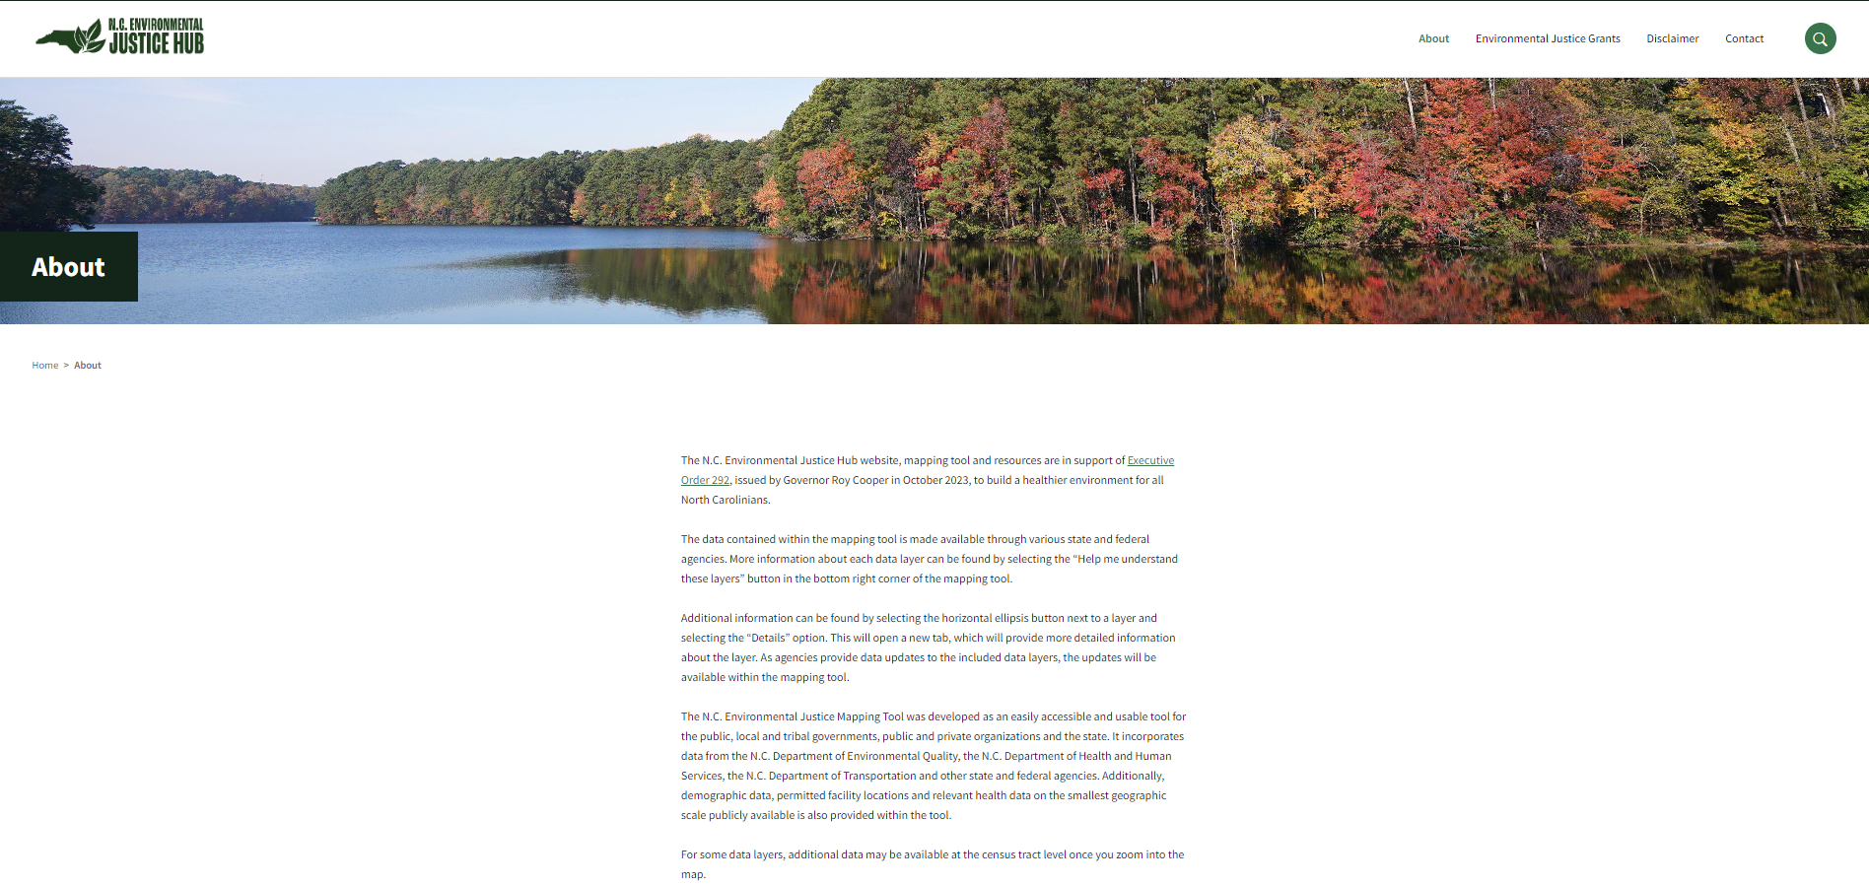
EJ Hub – Homepage Screenshot

Slide 10
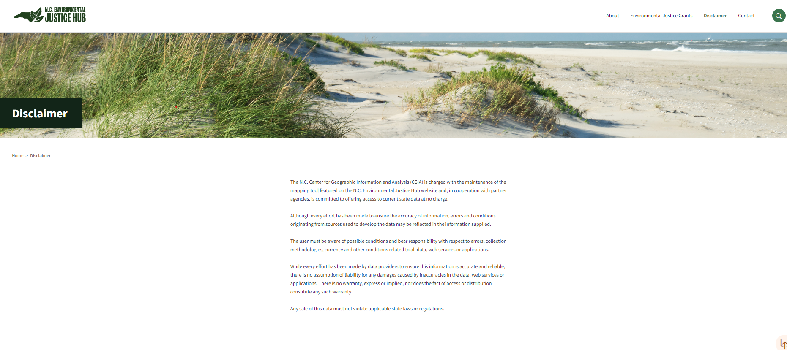
EJ Hub – Disclaimer Page Screenshot

Slide 11
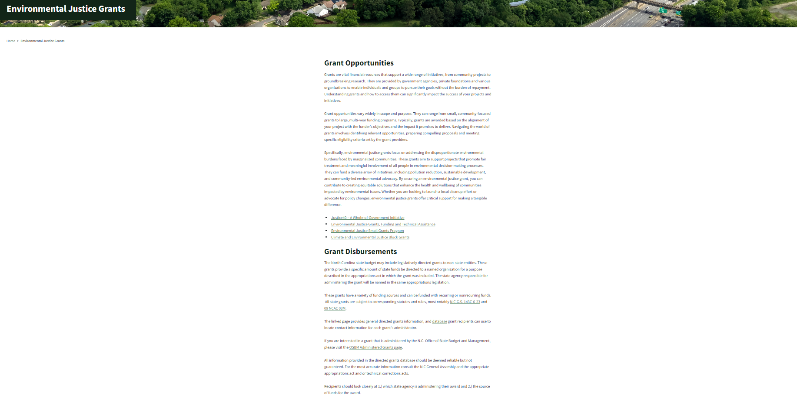
EJ Hub – Grants Page Screenshot

Slide 12
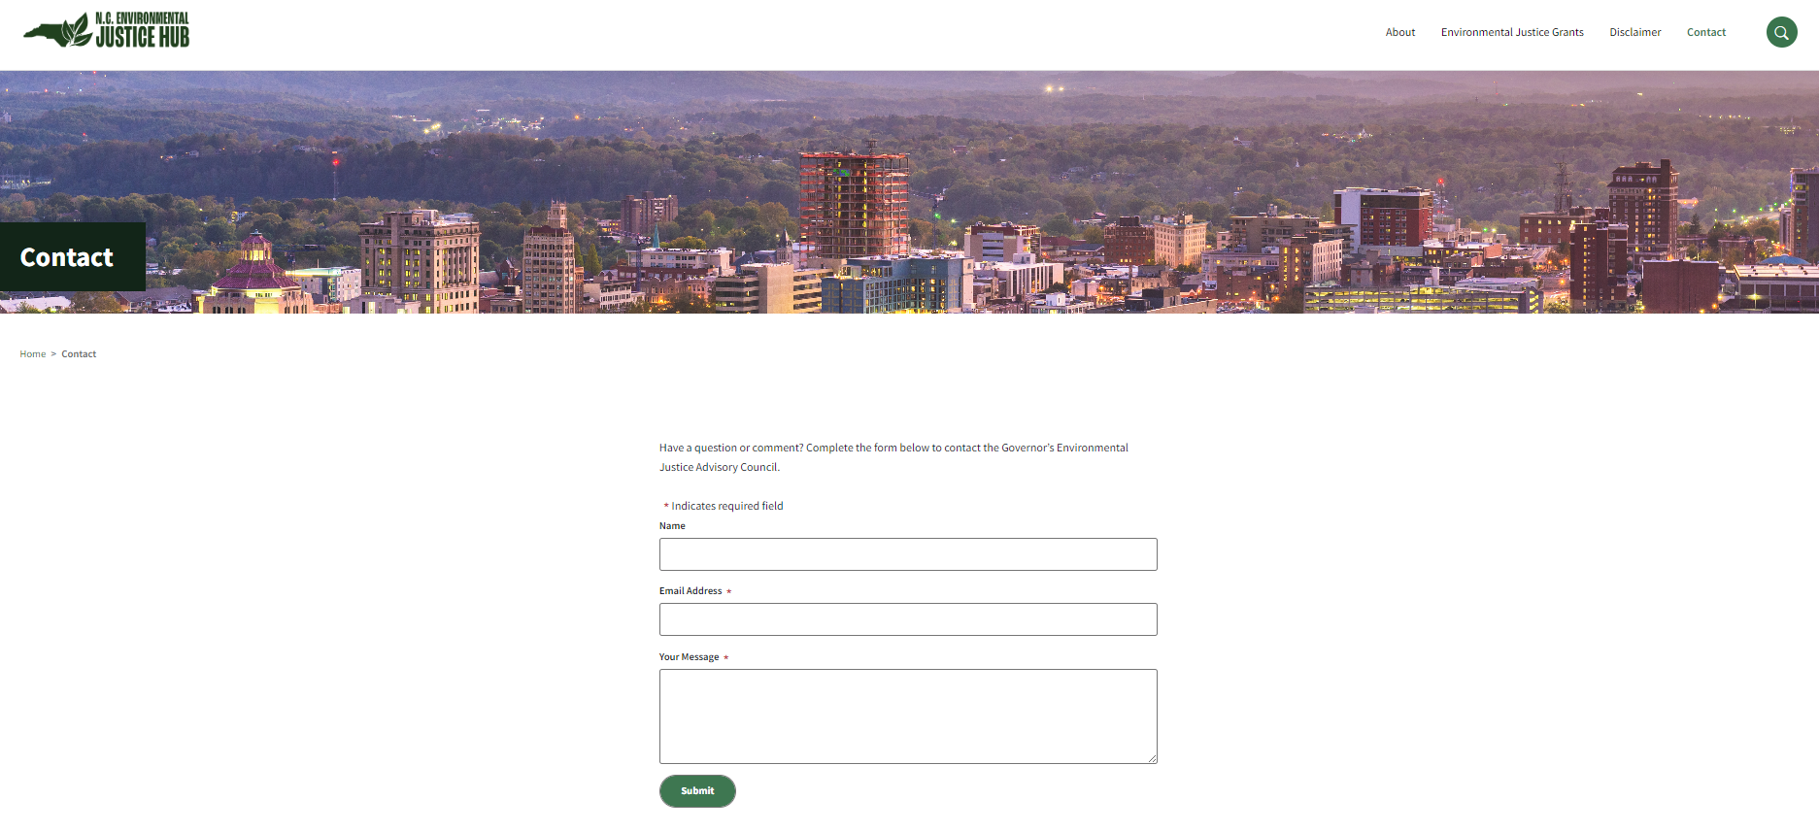
EJ Hub – Contact Page Screenshot

Slide 13
Agenda
Project Overview
Project Status, Accomplishments, and Work in Progress
Next Steps

Slide 14
Next Steps
Approval Request – The project team requests approval from the Council on the MVP to move forward with finalizing the MVP development process.
Complete the outstanding items of the council feedback list
Subcommittee or the Council to provide the following:
Begin the accessibility assessment process
Prepare MVP for roll out council approval
Create an intake form in the grants section to collect information from users on funding needs. | Need Council input - what information needs to be captured in the form and who should receive the responses?
Add an introduction to the EJ Hub that describes its purpose and that reflects on how NC government agencies are implicated in environmental injustice. This will help them introduce the tool and its goals and help the agencies begin to make change. | We request that the Council provide text to support this request. We can then add to the Mapping Tool splash screen.

Slide 15
EJ EO292
Mapping Tools & Hub Project
Questions?
Emad Khatib & David Giordano
DIT – PMO & Data Division
EJ Council Meeting
March 26, 2024

Slide 16
Supporting Slides

Slide 17
Project Process

Slide 18
Process Flow – Public Participation

