Slide 1
EJ EO292
Mapping Tools & Hub Project
Emad Khatib & Matthew McLamb
DIT – PMO & Data Division
EJ Stakeholder Meeting
May 21, 2024

Slide 2
Agenda
Project status
  Overall
  Update on accomplishments
  Prototype Demo
    Website Layout
    EJ data layers
    Grant
Risks and Issues
  Public feedback
Next Steps
  Demo for the Council members on May 28th
Misc.
  Enhancements Process flow of Public feedback if any

Slide 3
Project Status
Overall Project Status | On Schedule
Area | Status – DIT | Status – Agencies
Project Management Office
Deliverable - Scope Document | Complete 3/19/24 | Complete
Council Approval | Complete 4/1/24
Design – Mapping Tool | In Progress
Hub Website Development | In Progress
Unit Testing | In Progress
Council Approval - Prototype
UAT
Council Approval
MVP
Roll Out

Slide 4
Risks and Issues
Risks
Total | Open/Monitoring | Closed
4 | 3 | 1
Data agreement(s), if required. May not be able to secure timely. Council approvals. Public participation feedback impact on the timeline
Issues
Total | Open | Closed
7 | 0 | 7
 | Risks are low to medium severity and currently have no impact on
Notes:
Public participation – impact on the timeline and also slows the tech team to review, research, and map the list.
This will eventually impact the timeline as well.
I recommend we stay the EO original scope to launch n time and then get public feedback accordingly as it will be more valuable as enhancements.
Will discuss this at the end.

Slide 5
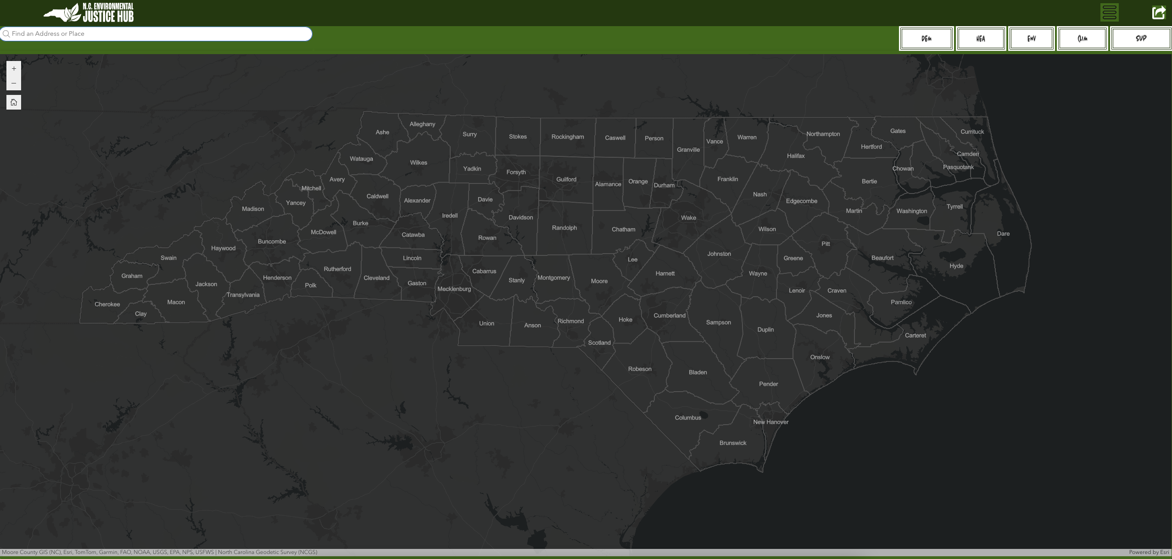
Prototype Demo – EJ Mapping Tool
 | Agency Mapping Tools
Data Element | DEQ's Environmental Justice Tool & Community Mapping System | DHHS Environmental Health Data Dashboard | DOT's EJ and Transportation Disadvantage Index mapping tool
Demographic Data on Census Block Level | X | X | X
Permitted Facility Locations | X | X
Relevant Health Data on smallest geographic scale publicly available | X | X | X
Ambient air quality data | X | X
Climate stressors such as flooding and sea level rise risk | X
Locations of sensitive receptors such as:
Schools | X | X
Nursing Homes | X | X
Affordable Housing Communities
Grants

Slide 6
Process Flow – Public Participation

Slide 7
Next Steps
Complete Sprint 2 – (initial mapping tool/mockup)
Demo prototype at the council meeting on May 28th
Obtain prototype approval from the EJ Council
Complete the site content
Identify data agreements needed, if any

Slide 8
Discussions/Decisions
  The DIT legal team is currently developing a disclaimer for the website.
  Search bar will be enhanced to include other types of identifiers (i.e. school…etc.)
  Working on how to show grant data on the map. Currently, the data contains only county names as a location identifier. Not all grant data specifies a county, so those grants would not be mapped if used as-is.
  Grant is based on fiscal year 2023 to show more data due to limited availability of fiscal year 2024 data.
  Additional grant filters will be implemented at a later stage, such as filtering by grant amount.
  Data pop-up boxes - Clean up will be done after the protype approval. Will be part of the MVP demo to reflect user friendly data pop-ups.
  Note that the NOAA sea level rise data is shown one layer at a time (0ft – 10ft).
  Prototype demo for the full council will be at the next council meeting on 5/28. The project team will distribute the mapping tool link and website screenshots to the council through the governor’s office policy team prior to the meeting.
  Suggestion - consider grants disbursement data from 2017 (when the current administration came to office) to cover the work that has been done. Recommend to be discussed with the council and the project team will be able to accommodate recommendation.
  What are type of grants that has been included? Grants data are wide open based on what the OSBM provides. The team can provide filtering based on key words; however, project team will need the council assistance in determining key words for filtering capabilities.
  Recommendation to link back to the OSBM site for grant information in lieu of providing it in the mapping tool. The project team is currently looking into the most effective approach.

Slide 9
Cont. - Discussions/Decisions
  Features/data within the mapping tool – population density data layer. The project team will evaluate.
  Request from the subcommittee to provide and identify list of the layers that are not included and how they are/will be phased into the mapping tool. The project will check the list and provide by Oct. Additional data layers will be added to the map once the prototype is approved.
  Search feature – suggestion to add a marker on the map to show the location of the feature searched. Project team is currently looking into adding a marker.
  User – function to tell any disproportionate impact/hazard in the area and compare to the state. This is related to scoring tool that is currently not in scope and would impact the timeline. Some of the data that is included and will be included in the map contains scoring.
  Information icon – consider a way to describe the data without going to another page. Project team will evaluate.
  Tutorial note– provide a tutorial for first time users. The project team will evaluate and consider options.
  Mobile device usage. Not within the timeline. Currently, the desktop version is in development. Mobile version can be considered for the future.
  Printing functionality – the print functionality is under development for screen print and ability to save as PDF.

