Slide 1
EJ EO292 Mapping Tools & Hub Project
Emad Khatib & Matthew McLamb DIT – PMO & Data Division EJ Stakeholder Meeting
September 17, 2024

Slide 2
Agenda
Project status
Overall
Feedback Status
Risks and Issues
Public feedback
Next Steps
MVP development
Misc.

Slide 3
Project Status
Overall Project Status | Public participation & feedback SC
Area | Status – DIT | Status – Agencies
Project Management Office
Deliverable - Scope Document | Complete 3/19/24 | Complete
Council Approval | Complete 4/1/24
Design – Mapping Tool | Complete
Hub Website Development | Complete
Council Approval – Design Prototype | 6/3/24
Data Acquisition | Complete
Public Participations* | Complete
Council Approval – MVP Prototype | Complete
MVP | Pending
Roll Out
* Based on EJAC schedule

Slide 4
Risks and Issues
Risks
Total | Open/Monitoring | Closed
4 | 2 | 2
Council approvals. May not be able to secure timely. Public Participation
Issues
Total | Open | Closed
9 | 0 | 9
 | Risks are low to medium severity and currently have no impact on

Slide 5
Status
Work completed on the council recommendations provided by the subcommittee (See below table)
Accessibility assessment completed (layer ordering, symbology, pop-ups, layer descriptions).
EJ Hub Site introduction text complete.
Contact form – email address established (ncejac@nc.gov).
Grant intake form – details sent to DIT to add to Hub Site
Attended all public engagement meetings.
Received and reviewed feedback from the council and public. Identified 63 enhancements and addressed items (16) that have no scheduling impact, including Misty Buchanan, DNCR, comment.
Rec. Period | # of Items | Accept | Reject | Complete To-Date | In Progress
For Prototype | 24 | 23 | 1* | 23
Grants | 3 | 3 |  | 3
By MVP | 10 | 9 | 1** | 7 | 2
Total | 37 | 35 | 2 | 33 | 2
* Turn on/off layers with one click is not available within the application – Enhancement
** Unable to clip the NOAA data. Dropped

Slide 6
Public Feedback – Completed Items
Group Heat Prediction layers within one group
Adjusted layer drawing order to ensure points are visible on top of polygons (3 comments related to this topic)
Spelled out TDI
Display shading at the tract level for all race categories
Adjusted the titles for most of the health layers to ensure rate per population was included (4 public comments related to this, 34 updates made to ensure consistency)
Added a legend for the “Community Access to Broadband Funded Locations” layer
Moved the “Managed Conservation Areas” layer from Environmental to the Supporting Data category
Adjusted the transparency of the polygon layers to allow you to see the road name details beneath
Added text to the splash screen alerting users that some layers have tract level data when you zoom in
Updated the “TDI” layer description in the “Help me understand these layers” tool to include more descriptive text

Slide 7
Action Items - Status
Develop the grant intake form information in the hub. In progress – DIT adding to Hub Site
Develop the how-to video and publish to the About page
Finalize the contact form Submit button – need email address for the Governor’s Environmental Justice Advisory Council.
Complete the accessibility assessment (pop-ups, symbology, data layer descriptions)
Add the introduction text to the EJ Mapping Tool and Hub Site as provided by the Governor’s Office
Prepare for final MVP demo for council approval to roll out the HUB and Mapping tool.

Slide 8
Next Steps
Develop the how-to video and publish to the About page
Grant inquiry form being added to Hub Site by DIT
Obtain approval from the Governor’s office to lunch Hub site and Mapping tool to the public
Launch the EJ Mapping tool and Hub
Send enhancements list to the Governor’s Office
Complete PTA (Privacy Threshold Analysis)

Slide 9
Discussions/Decisions

Slide 10
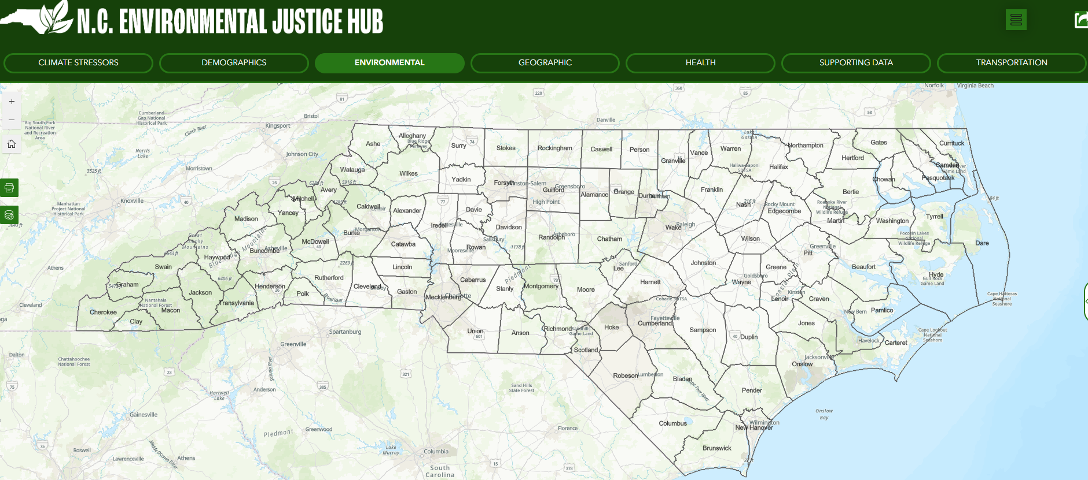
Prototype Demo – EJ Mapping Tool
 | Agency Mapping Tools
Data Element | DEQ's Environmental Justice Tool & Community Mapping System | DHHS Environmental Health Data Dashboard | DOT's EJ and Transportation Disadvantage Index mapping tool
Demographic Data on Census Block Level | X | X | X
Permitted Facility Locations | X | X
Relevant Health Data on smallest geographic scale publicly available | X | X | X
Ambient air quality data | X | X
Climate stressors such as flooding and sea level rise risk | X
Locations of sensitive receptors such as:
Schools | X | X
Nursing Homes | X | X
Affordable Housing Communities
Grants
Prisons & State-Owned Properties

