Slide 1
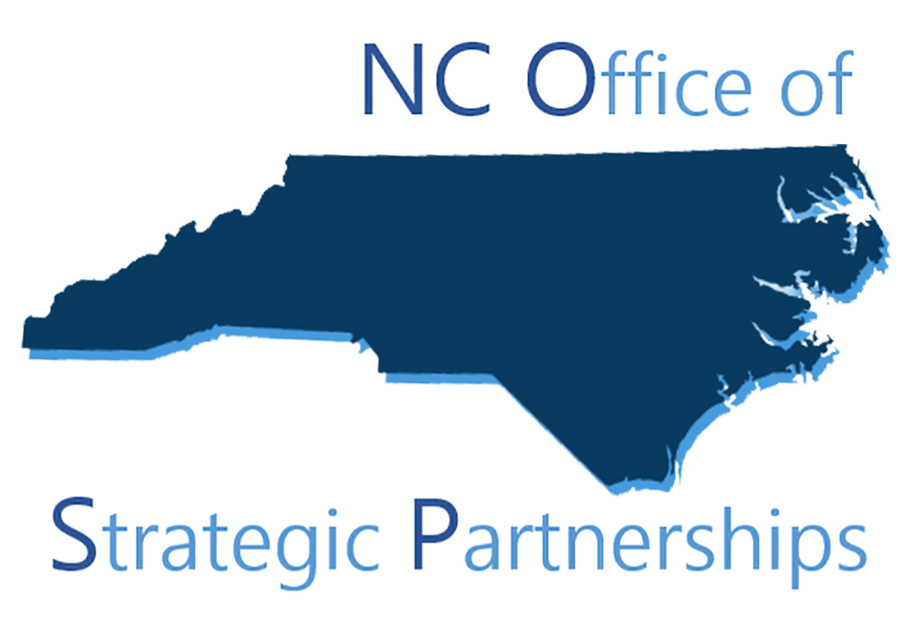
North Carolina Office of Strategic Partnerships
Overview & Discussion
for meeting of the
Governor’s Environmental Justice
Advisory Council
January 30, 2024

Slide 2
NC Office of Strategic Partnerships
What Does Executive Order 292 Say about OSP?
Overview of OSP
How can OSP support the Governor’s Environmental Justice Advisory Council?
Q&A
NC Office of Strategic Partnerships

Slide 3
What Does Executive Order 292 Say about OSP?
Section 5. Powers of the Council.
The Council may:
Consult with the NC Office of Strategic Partnerships for recommendations and guidance to determine effective strategies for engaging with North Carolina;
Collaborate with the NC Office of Strategic Partnerships to identify sources of expertise about existing and potential EJ research projects and topics;
Collaborate with the NC Office of Strategic Partnerships and other state agencies to develop government-research partnerships focused on EJ;
Section 11. Cumulative Impacts.
The Council, in consultation with the NC Office of Strategic Partnerships, shall engage with academia, prioritizing Historically Black Colleges and Universities and other Minority-Serving Institutions, and other research institutions to conduct research on cumulative impacts in North Carolina and develop recommendations for creating a framework and methodology to assess cumulative impacts.
NC Office of Strategic Partnerships

Slide 4
Overview of OSP
NC Office of Strategic Partnerships

Slide 5
NC Office of Strategic Partnerships
The North Carolina Office of Strategic Partnerships (OSP) develops, launches, and enhances partnerships between state government and North Carolina’s research and philanthropic sectors. This includes elevating the State’s internal capacity to use and generate evidence in its policy and programmatic functions.
Strive for partnerships that are scalable, sustainable, and develop public/open-source resources
Multiple sectors, many partners: state agencies, colleges/universities, philanthropy, national organizations
NC Office of Strategic Partnerships

Slide 6
NC Office of Strategic Partnerships
We and our partners across sectors…
Focus on
Leveraging the expertise of research institutions (higher ed+) and philanthropy
Using research and evidence to guide policy and process decisions
Work with government to define and refine research questions, describe desired deliverables, identify research partners, and ensure resources for long-term sustainability and impact
Have developed and implemented replicable processes involving government, research, and philanthropy partners
Create and offer opportunities for many types and levels of engagement (short- and long-term; faculty, researchers, students; funded, pro bono, etc.)
NC Office of Strategic Partnerships

Slide 7
NC Office of Strategic Partnerships
Our partnership development process includes…
Agency learning/research priorities → project sourcing, development, identifying partners
Examples: NC Wildlife Resources Commission, NC Dept. of Commerce, NC Dept. of Information Technology
Multi-step, flexible process for agency-researcher connections
Using the North Carolina Project Portal to help share, request, invite research expertise and partnership
350+ researchers at ~50 institutions of higher ed have expressed interest in partnering with government (and/or have entered into partnershps)
Daily requests for assistance from universities, state agencies, nonprofits, philanthropy, others re: policy engagement, engagement w/researchers and philanthropy, agency sources of expertise, range of guidance
NC Office of Strategic Partnerships

Slide 8
If you’re inside government…
Think of one or more issues that you or your agency, division, office, etc. work on, have worked on in the past, or are considering working on.
Now think of
Questions related to that work that you wish you had the answers to
Challenges related to that work that you wish you could address successfully
These could be about a program, a policy, funding, internal operations…
Now consider why you don’t know the answers to those question or how to address the challenges. What’s missing? What do you need?
NC Office of Strategic Partnerships

Slide 9
If you’re outside government…
Think of issues and topics that you work on (or plan to work on) and have expertise in that have relevance to government policy and/or programs.
Now consider -
Does anyone in government know that you’re working on that?
Did you/do you talk with people in government before, during, or after doing that work?
Do you proactively try to learn about what people in government are focusing on and/or planning to focus on?
If answers to any of the above are no or mostly no, consider why that is and what would change the answers to yes. What’s missing? What do you need?
NC Office of Strategic Partnerships

Slide 10
How can OSP support the
Governor’s Environmental Justice Advisory Council?
NC Office of Strategic Partnerships

Slide 11
OSP Supporting the EJ Advisory Council…
Possibilities for initial discussion:
1. Sources of expertise about existing and potential EJ research projects and topics
Council members, agency experts, many others (including NC’s 110 institutions of higher education)
2. Government-research partnerships focused on EJ
Existing agency priorities, researchers’ relevant existing and planned research, other organizations’ current and recent recommendations
3. Engage with academia on cumulative impacts in NC & framework and methodology to assess cumulative impacts.
Likely a multi-part project with involvement from government, research, possibly others (e.g., industry, philanthropy); intentional involvement of HBCUs and MSIs
4. Effective strategies for engaging with North Carolina
For discussion/clarification with Council
NC Office of Strategic Partnerships

Slide 12
OSP Supporting the EJ Advisory Council…
The Council could use these and other OSP/partner approaches for impact and opportunity:
Government-research partnership projects – facilitated 40 (to date) and 35+ research partnership interest meetings w/15 Cabinet and Council of State agencies
The NC Project Portal - created to catalyze collaboration among state agencies, research institutions, and philanthropy to address government research needs.
Ed2NC - launched as a partnership w/NC Office of State Human Resources, to strengthen the state government talent pipeline. Already includes 75+ representatives from colleges/universities and state agencies and has developed publicly available resources.
Research fellowships – for example, OSP inspired the UNC Collaboratory to create and fund the NC Department of Environmental Quality (DEQ) Applied Research Fellowship, which strengthens partnership between DEQ and academic experts on a priority issue that impacts many North Carolinians.
NC Office of Strategic Partnerships

Slide 13
Q&A
NC Office of Strategic Partnerships

Slide 14
OSP Resources
OSP Website
NC Project Portal: Research partnership opportunities with government agencies
State agency contacts for partnerships and research
College and university contacts for partnerships and research
Evidence Advisor overview and examples of building government’s internal capacity for generating and using evidence
Philanthropy Liaison resources focused on engagement and partnership between government and philanthropy
Monthly Connect: Panel discussions on cross-sector partnerships – view recordings of over 35 sessions to date; sign up here
Highlights (monthly e-news and resources); sign up here
Contact partnerships@osbm.nc.gov with questions, partnership ideas, and requests.

Slide 15
Thank You
Thank you to:
NC Office of Strategic Partnerships Advisory Group
Partners at state agencies, colleges and universities and philanthropies
The many other partners who engage with and support the NC Office of Strategic Partnerships

